Slide 1
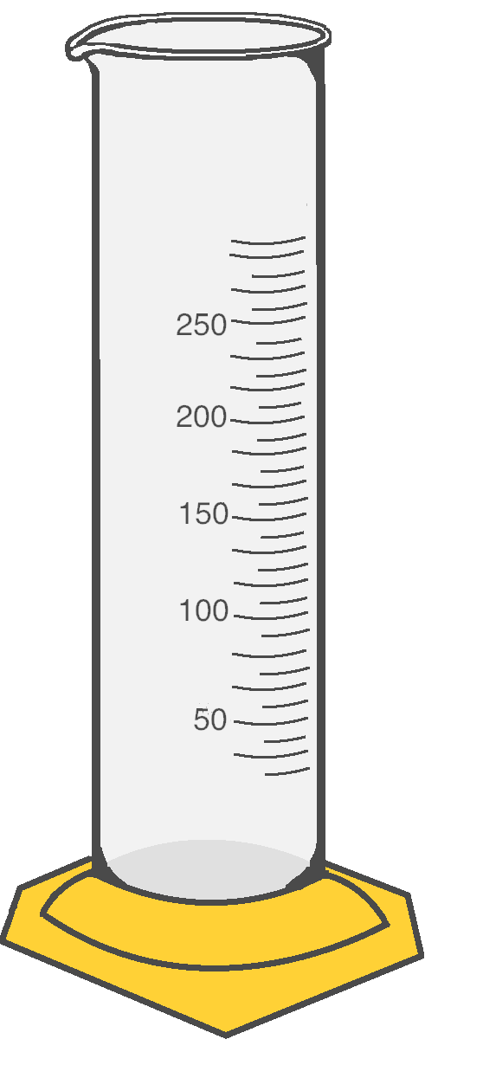
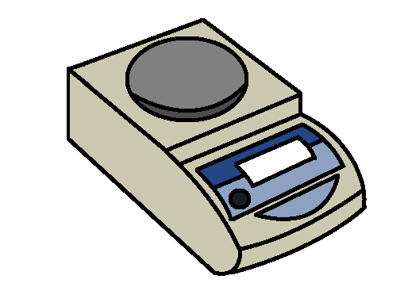
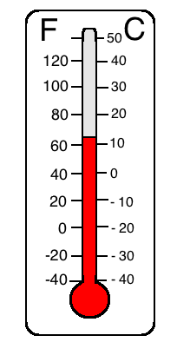
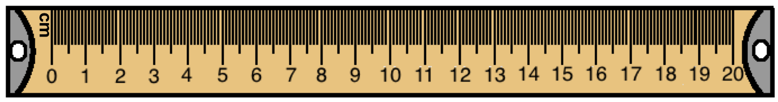
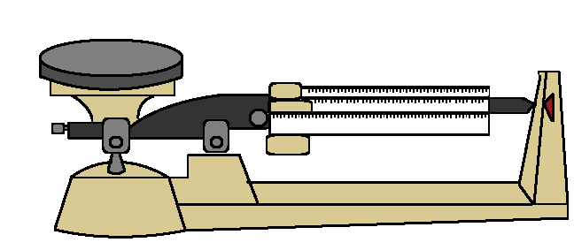
Tools of Science
Includes Lessons on measuring Volume (including displacement), Length, Temperature, Weight & Mass
0.00
Notes:
Everyday

Slide 2
Volume
Metric System (SI) Units for Volume:
1 Liter (L) = 1000 Milliliters (mL)
1 Milliliter (mL) = 1 Cubic Centimeters (cm³)
Volume is the amount of three-dimensional space something takes up.
The Base Unit for Volume using the Metric System (SI) is Liter.
Solids, liquids, and gases all have volume.
Volume is measured differently for solids, liquids, and gases
U.S. Customary Units to the Metric System (SI):
1 Gallon (G) = 3.78541 Liters (L)
1 Tablespoon (tbsp) = 14.7868 Milliliters (mL)
Graduated Cylinder
Notes:
If kids

Slide 3
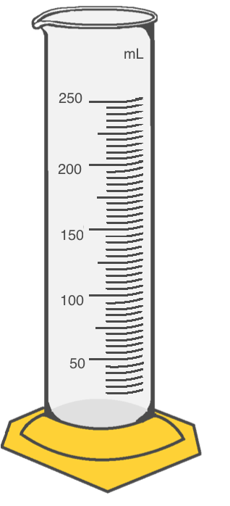


Displacement
Finding Volume:
Displacement helps us find the volume of an object.
To find this volume, we fill a graduated cylinder with a certain amount of water (let’s say 50 L). Then, an object is placed in the graduated cylinder and the water rises (let’s say it rises to 150 L).
We can see that our object had a Volume of 100 L. Since no additional water was added, we know that the amount the water rose is the volume of the object we placed in the water!
150 L – 50 L = 100 L
150 L
50 L

Slide 4
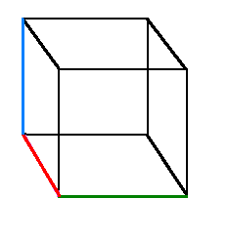
Length
Metric System (SI) Units for Length:
1 Kilometer (km) = 1000 Meters (m)
1 Meter (m) = 100 Centimeters (cm)
1 Centimeter (cm) = 10 Millimeters (mm)
Length is used to measure distances.
The Base Unit for length using the Metric System (SI) is Meter.
Length can describe the dimensions of an object (length, width, height) or can describe the distance between two objects.
U.S. Customary Units to the Metric System (SI):
1 Inch (in) = 2.54 Centimeters (cm)
1 Foot (ft) = 0.3048 Meters (m)
1 Mile (mi) = 1.60934 Kilometers (km)
Dimensions
Volume =
Length x Width x Height
Height
Width
Metric Ruler
Length

Slide 5
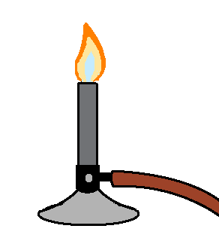
Metric System (SI): Celsius
Temperature
Freezing point = 0° C
Boiling point = 100° C
Temperature is used to describe the amount of heat energy present or the lack of heat energy in an environment (how hot or cold something is).
In the Metric System (SI), we measure temperature using degrees Celsius.
There are Freezing Points and Boiling Points in temperature scales:
Freezing Point: the temperature where water becomes a solid
Boiling Point: the temperature where water evaporates (becomes a gas).
U.S. Customary: Fahrenheit
Freezing point = 32° F
Boiling point = 212° F
Bunsen Burner:
Used to heat substances in a laboratory setting
Thermometer:
Used to measure temperature of the environment

Slide 6
Weight and Mass
Metric System (SI) Units for Length:
1 Kilogram (kg) = 1000 Grams (g)
1 Gram (m) = 1000 Milligrams (mg)
Weight is the measure of the downward force of an object due to gravity and is used to find an object’s Mass.
The Base Unit for mass using the Metric System (SI) is the Kilogram.
We use Scales to weigh objects. However, scales are set to give you the object’s mass and not the object’s weight.
U.S. Customary Units to Metric System Units (SI):
1 Pound (lb) = 0.453592 Grams (g)
1 Ounce (Oz) = 28349.5 Milligrams (mg)
Some of the Tools Used to Find Mass and Weight:
0.00
Scale
Triple Beam Balance

Slide 7
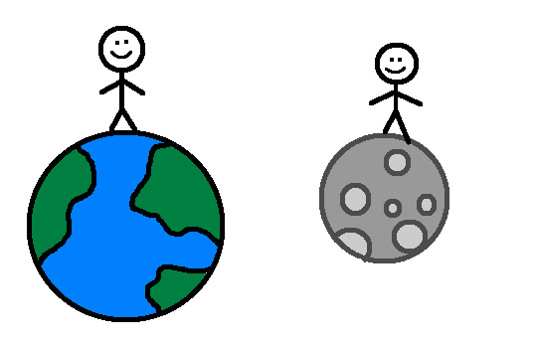
Weight vs. Mass
You would weigh about 16.6 pounds on the moon!
If I weigh 100 pounds on Earth, I wonder what I would weigh on the moon?
Weight and Mass are not the same thing:
Mass is how much matter an object or substance contains.
Weight is the Mass of an object combined combined with the force of gravity pressing down on that object.
Balances or scales are used to find the weight of an object. Then, the Weight is used to calculate the object’s Mass.
If you were on the moon, you would weigh less (because there is no gravity) but you would still have the same mass.

